Slide 1
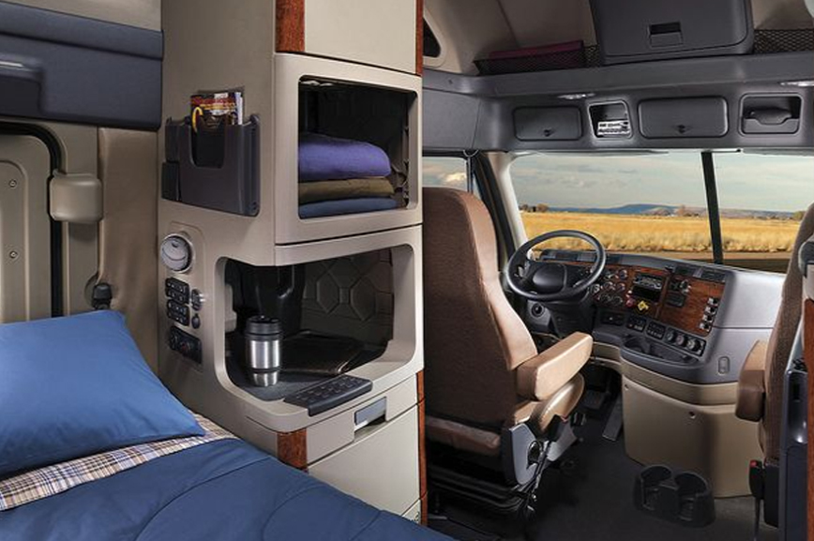

NO EMPTY SEATS ON YOUR FLEET Strategic Solutions to Commercial Driver Recruitment and Retention
Notes:
Hi, we are transalytics, a logistics and supply chain consulting firm. We help trucking companies determine who to hire using data analytics. Our goal is to leave you with no empty seats on your fleet.
The transportation industry is experiencing a large driver shortage that is expected to increase over time. What happens when there aren’t enough qualified drivers to move the products we rely on everyday? Think about it, everything in this room moved on a truck. We all love our same day or one day shipping offered by companies like Amazon and Walmart. As the driver shortage increases, cost of goods will increase as well as delays within the supply chain.

Slide 2

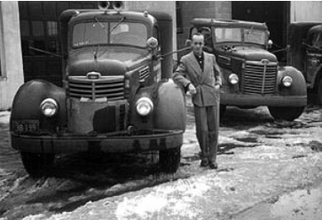
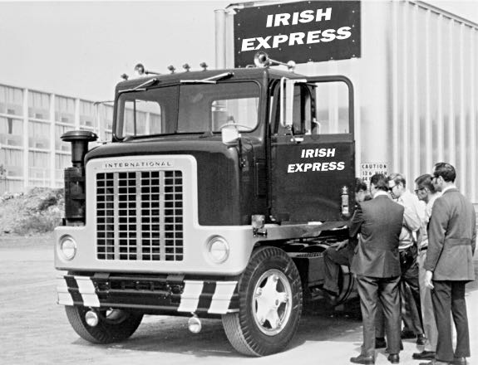
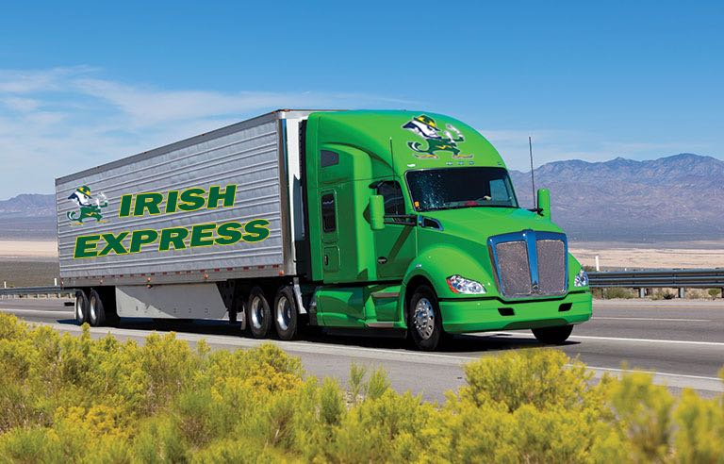

IRISH EXPRESS STORY
IRH EXPRESS
5
950
3,150
Established in
1958
Largest in Midwest
1980
Today
Notes:
Before we jump into the presentation, I would like to tell you more about our client.
After the Korean War, Paul O’Brien returned home to his family farm in Dekalb, IL. Paul was in charge of driving their crop to markets around the Chicagoland region.
The family business was growing and they needed a more efficient way of delivering their crop to customers in the area
In 1958, Paul decided to purchase 5 trucks and start a trucking company to help farmers like his family move product to the end consumer
Irish Express grew rapidly over the years and in 1980 their truck count was just under 1000
Today, Irish Express operates over 3000 trucks nationally with their headquarters here in Chicago
The business is still family owned and operated as well as debt free

Slide 3
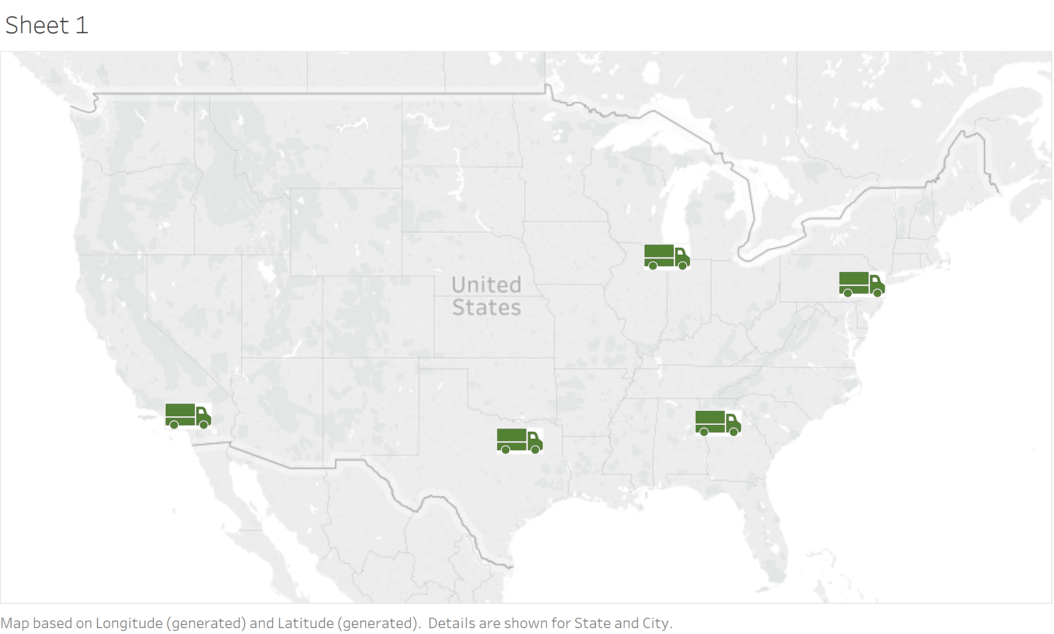

NATIONAL FOOTPRINT
IRISH EXPRESS
# of Drivers
2,800
HQ: CHICAGO
# of Trucks
3,150
# of Trailers
6,000
Drop Yard
Terminal
Notes:
-As mentioned in the previous slide, Irish Express is a national carrier with a large footprint
-They operate in 5 terminals and 8 drop yards across the united States
-The green trucks represent their terminal locations where they have operations teams and driver lounges
-The red pins represent the drop yards where they store trailers and have mechanics on site
-Irish Express currently has about 2800 drivers in their network of 3150 trucks and 6000 trailers
-The truck is the part of the vehicle where the driver sits and the trailer is towed behind
-The increase in the driver shortage has left over 300 trucks empty over the past year
-Every day that a truck is sitting empty...Irish Express is losing money
Terminals: Fontana, CA; Dallas, TX; Chicago, IL; Atlanta, GA; Allentown, PA
Drop Yards: Sacramento, CA; Las Vegas, NV; Salt Lake City, UT; Laredo, TX; Kansas City, MO; Cleveland, OH; Charlotte, NC; Portland, ME

Slide 4
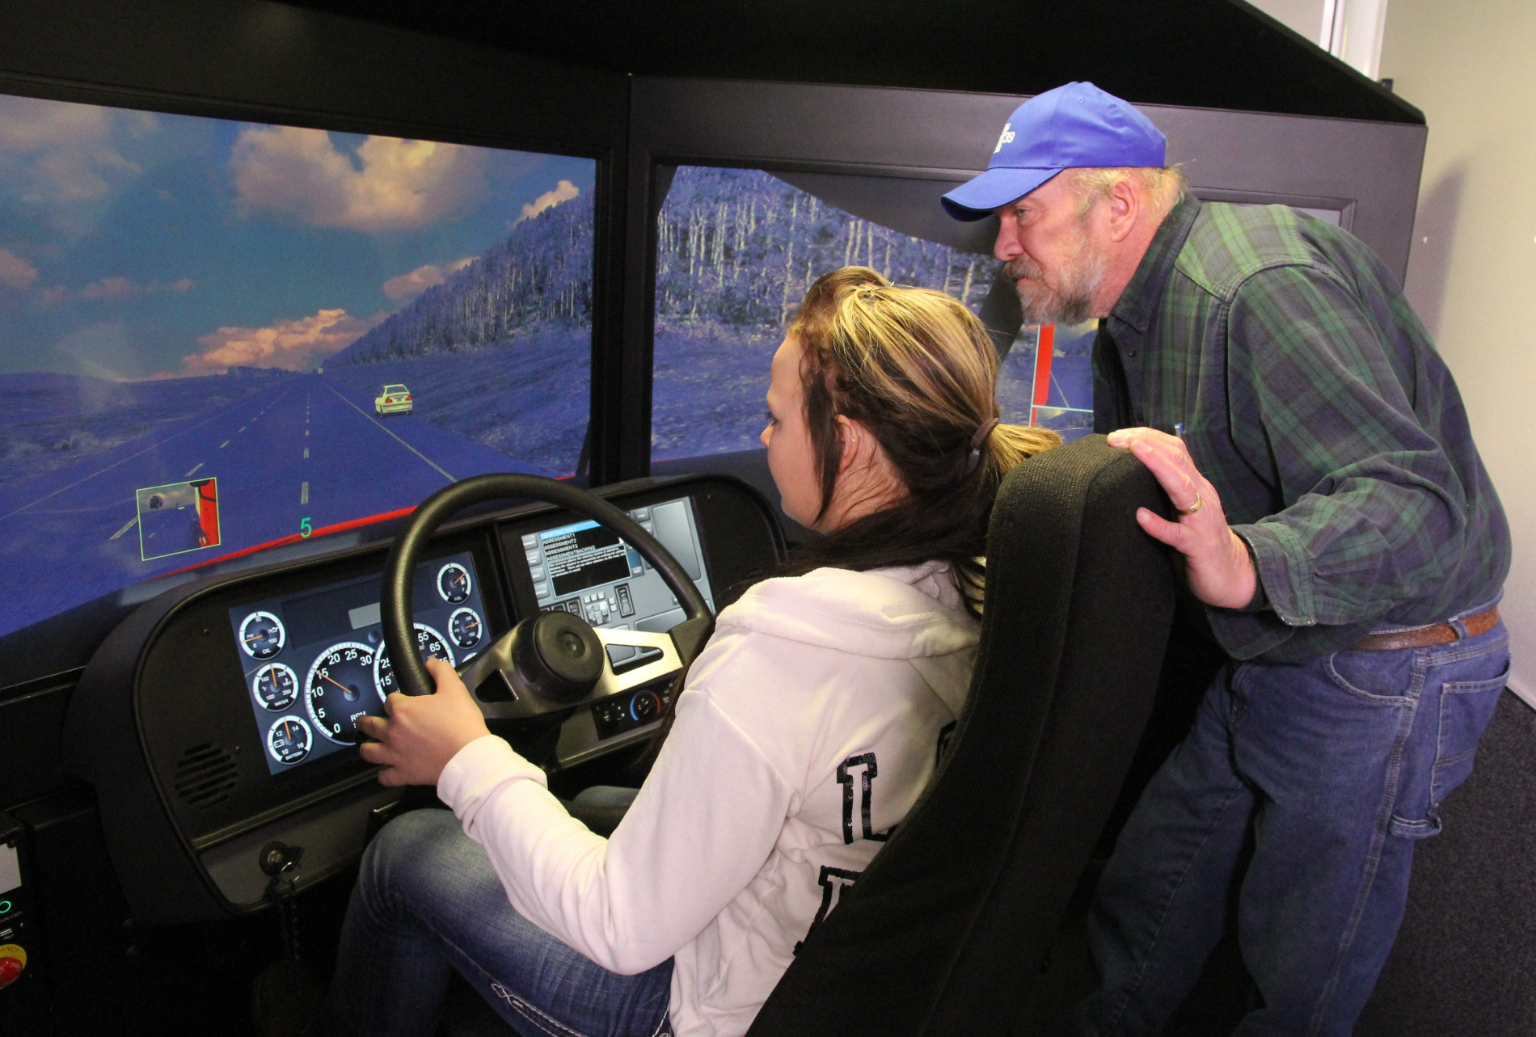

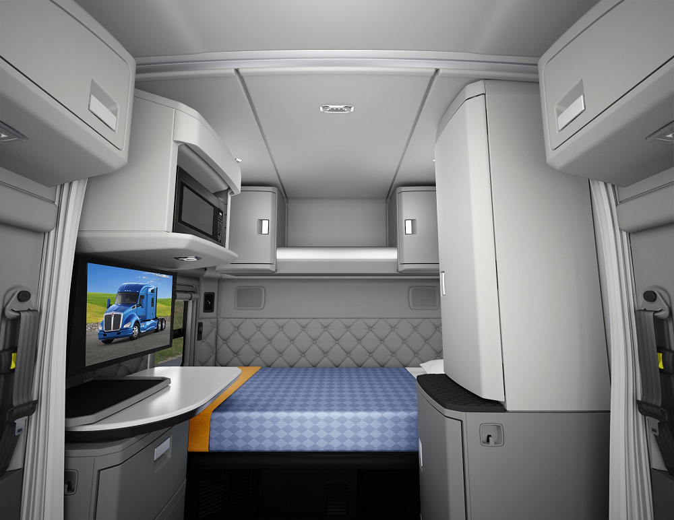
BENEFITS HIGHLIGHTS
CDL Training Program
$10K Annual
Safe Driving Bonus
$5K Annual
Tuition Reimbursement
Notes:
Irish Express offers great benefits to their drivers
-Irish Express has CDL training programs at each of their terminal locations:
-This program is great for those that are interested in getting into the industry
-They also offer their drivers a $10k safe driving bonus annually as well as $5k in tuition reimbursement to be used by themselves or an immediate family member
-They have invested in new technology and offer driving simulation courses for those interested in becoming drivers
-They have remodeled all of their driver lounges at the terminal locations. Drivers can do laundry, shower, or rest while on their breaks
-They also purchase new sleeper cabs each year fully equipped with DirecTV and WiFi for those on the road all the time

Slide 5




ISSUE TREE
Irish Express would like to know who to target as potential drivers willing to stay for a minimum of 12 months.
Reduce Company Driver Shortage
Attract Loyal Drivers
Increase Seated Truck Percentage
Maximize Net Profit
Notes:
Allison

Slide 6
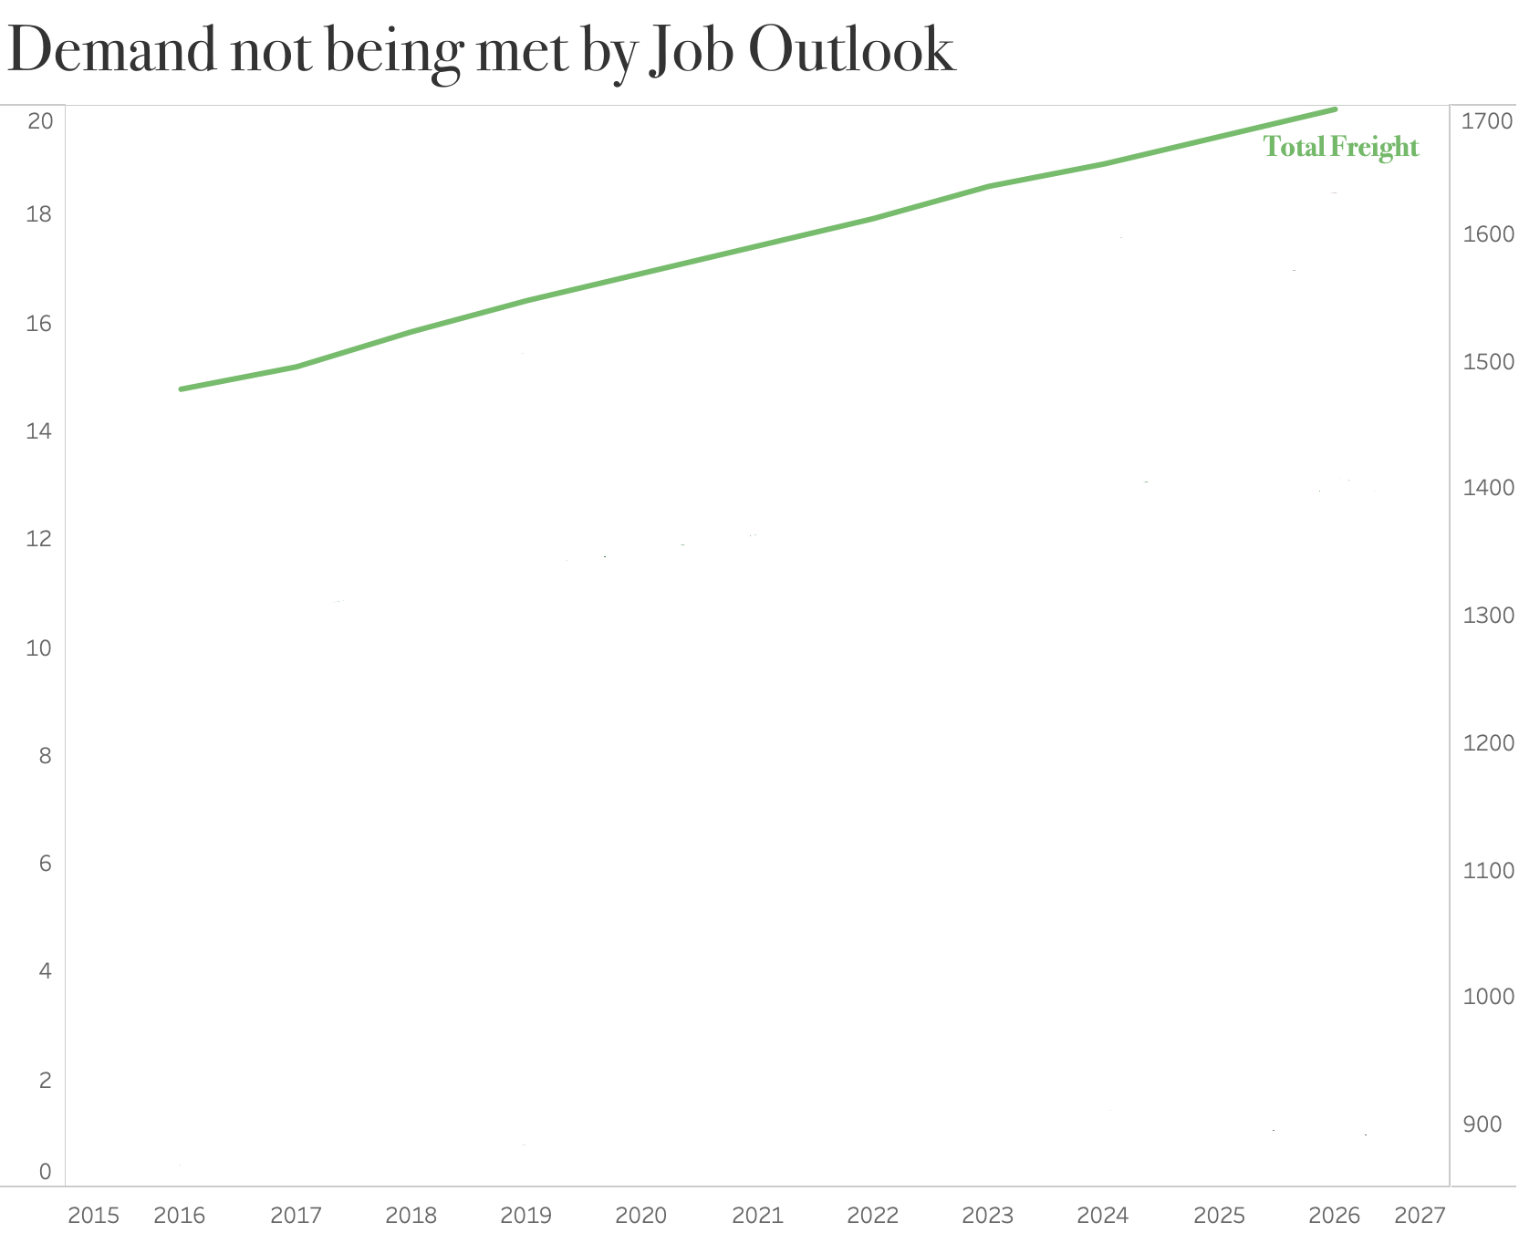
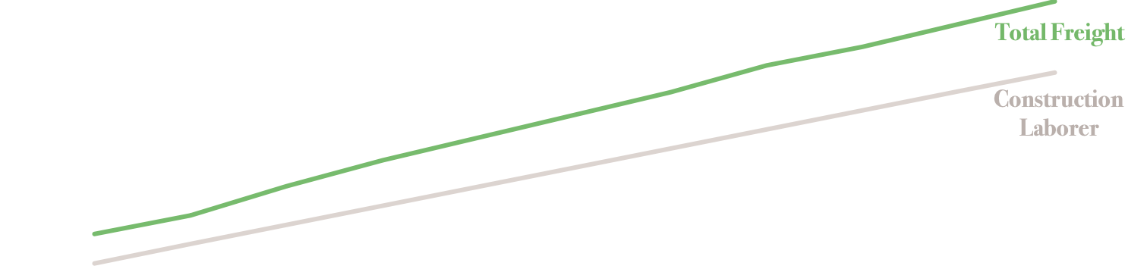
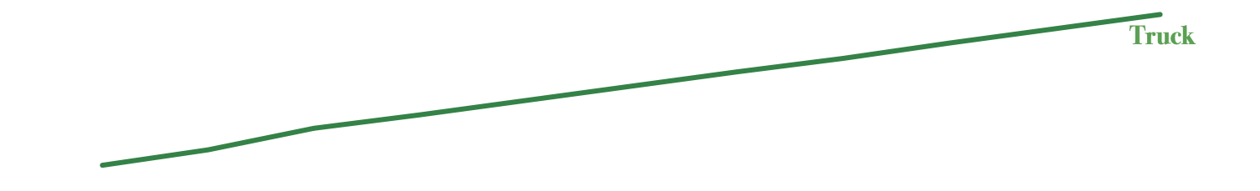
INDUSTRY DEMAND
Volume
(Bil. of Tons)
Employment
(Thou.)
Total Freight Tonnage Growth
35.1%
Truck Driver
Job Outlook
6.28%
Construction Work
Job Outlook
12.5%
Truck Tonnage Growth
29.3%
Source: Fleet Owner 2018
Notes:
Allison

Slide 7
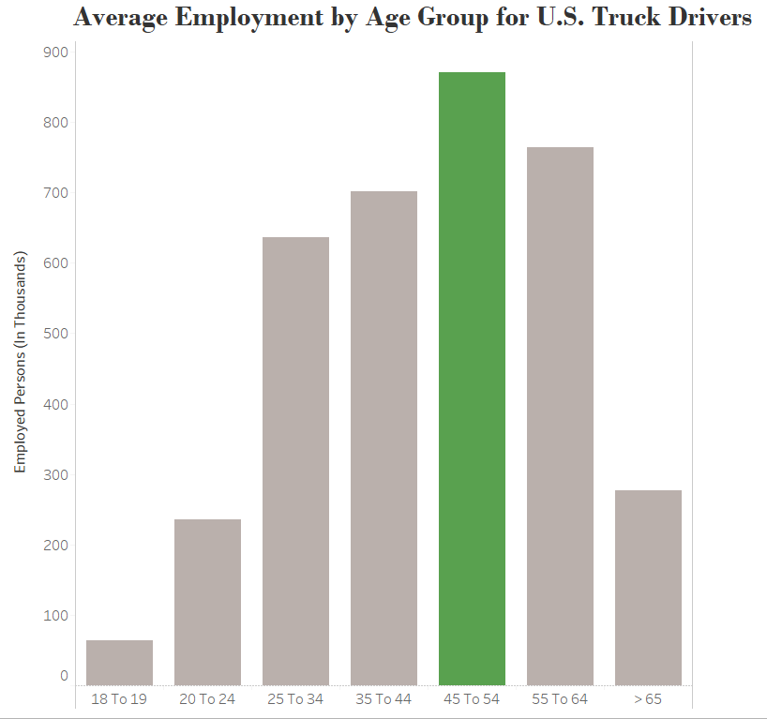
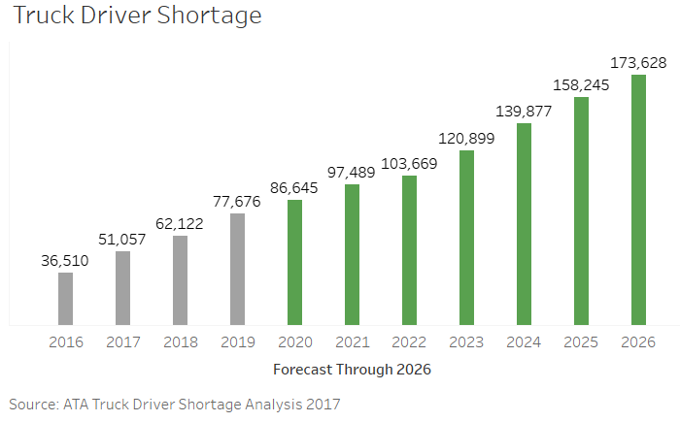
INDUSTRY UPDATE
Source: ATA Truck Driver Shortage Analysis 2017
Source: U.S. Bureau of Labor Statistics
Notes:
Allison

Slide 8
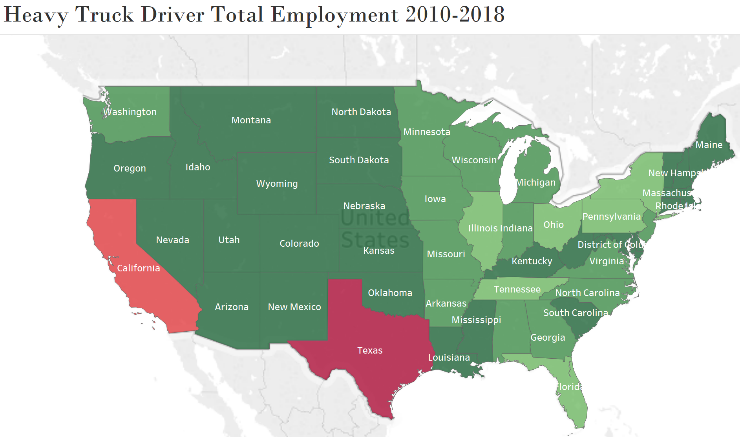
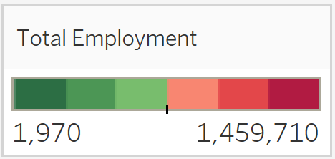
INDUSTRY UPDATE
Top 5 States:
Texas
California
Pennsylvania
Florida
Ohio
Source: U.S. Bureau of Labor Statistics
Notes:
(Heavy Truck Driver Employment Totals by state)
Update map

Slide 9



CURRENT CHALLENGES
Work Force Retirement
Unsuccessful
Recruitment
Employee Retention
Notes:
Amy

Slide 10

The FightingChirish Advantage
OBJECTIVES
Higher Profit Margins
Happier Employees
Continued Growth
Notes:
Amy
We use a structured and highly-focused approach to recruiting and retention, to help you maximize driver retention, and minimize expenditures on recruiting, ultimately leading to:
Higher profit margins
Happier employees who stay with Irish Express longer
A stronger company that is better able to meet the growing freight transportation demands both today, and into the future

Slide 11

What sets us apart? (our special sauce)
STRATEGIC APPROACH
Workforce Growth
Data Collection
Marketing Tools
Key Factors
Targeted Candidates
Notes:
Amy
We use a strategic approach to collect relevant data, have successfully help other clients
We use this same type of strategic, targeted approach to not only analyze your existing employee data and select the right types of candidates…
But we also take this same approach to help you figure out whom to target and the best methods of reaching them, to maximize your chances of getting the right candidates and employees

Slide 12
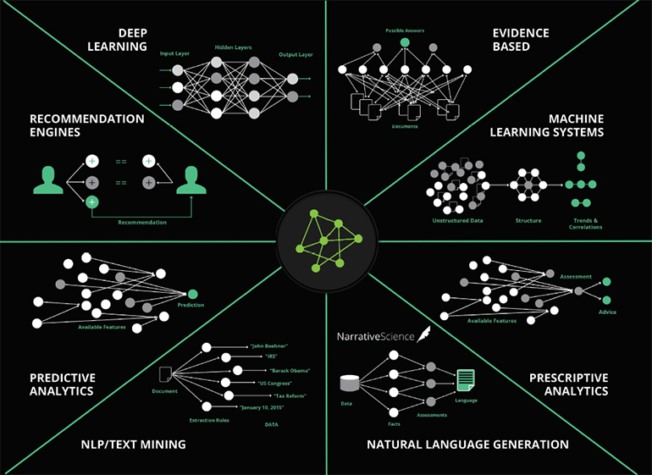


OUR METHODOLOGY
Your Data
Customized Model
Target
Audience
+
=
Notes:
The image in the middle shows just a few of the examples of the types of analytics tools that we use to analyze your data and
come up with the best analytics approach for your particular types of data, and
provide the most accurate predictions for your company to be able to target the types of individuals you’ve told us are important to you:
people who will stay with Irish Express as long-term, loyal employees, for at the very least, 12 months
For anyone in the room who is interested in learning more about our specific analytics approaches, we will send the slide deck to your team after the fact, and this image is hyperlinked to our analytics page that will walk you through our approaches a bit more in-depth. We are also available to discuss and answer questions about any of the particular analytics approaches with any of you after this presentation. Please feel free to each out to anyone on our team at our contact information on our last slide.

Slide 13
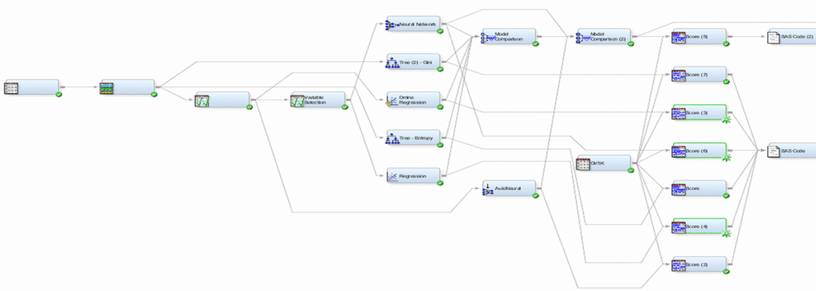


What sets us apart? (our special sauce)
OUR METHODOLOGY
Notes:
For those of you interested in our specific analytics approaches, diving a bit deeper into some of the approaches we use more often – we begin, first-off with a black-box approach, starting with more basic analyses, such as linear and logarithmic regression approaches, nearest-neighbor approximations, and classification trees, and move to more complex deep learning and neural network approaches.
Our proprietary series of analytics models and metrics are designed and developed, over many iterations and with many years of experience in similar types of datasets and industry problems, to figure out the best approach to your particular business problem of targeting the best employee candidates, at a rate of response, application, and retention beyond 12 months, far above the success rates that you currently have with your current recruiting and retention model.

Slide 14


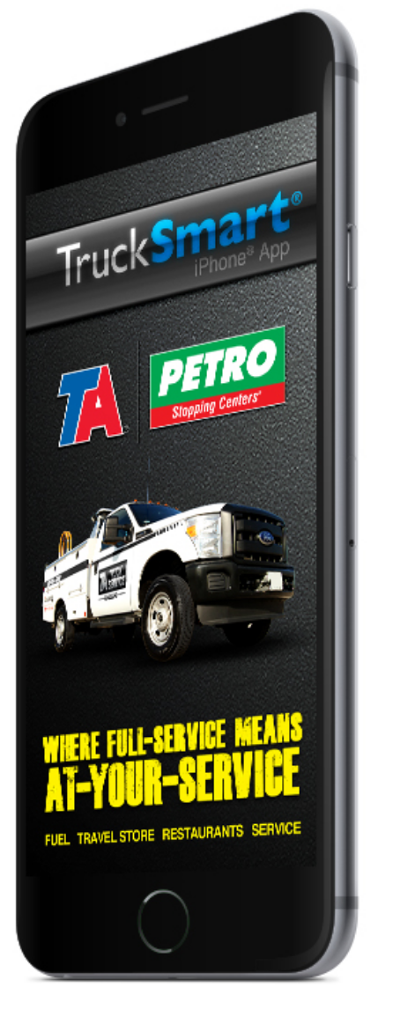


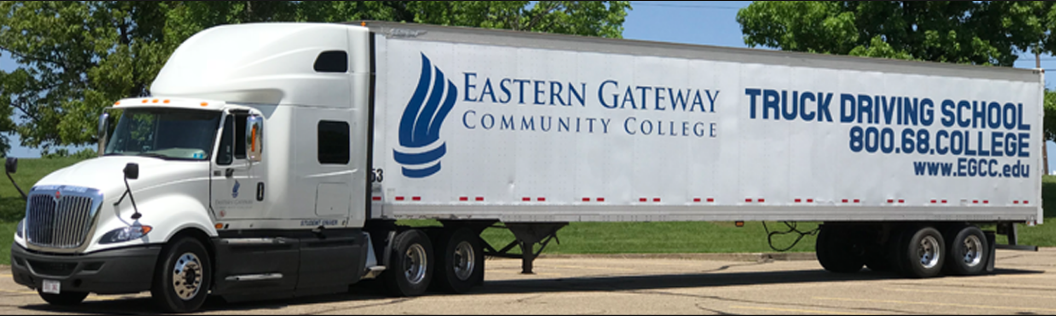
What sets us apart? (our special sauce)
MARKETING TOOLS
Notes:
In addition to helping you figure out the best candidates to target for employment offers and for your CDL program, our analytics approach also provides you with a highly-specific and accurate list of tools and platforms where you should target your advertisements to reach the appropriate audiences of candidates, on apps, sites, and platforms that they already visit frequently and where they are most likely to see and respond to your advertisements.
This slide shows some marketing platforms that our preliminary analysis of the commercial truck driving market and potentially target audiences, shows as being frequently visited by the potential target audiences, such as:
For candidates not currently in the truck driving industry, apps such as facebook, waze, and GasBuddy are platforms that can be used to target potential candidates interested in driving and travel
For candidates that would be targeted for transition from other competitor carriers, apps like TruckerPath, which drivers frequently use to find amenities and weigh stations along routes, can be used to target transfer candidates
And for younger candidates, or those who are looking for a career change, our algorithm may recommend that an ideal approach would be to partner with local community colleges who offer commercial driver licensing programs, and that targeting those candidates may be best directly through their community college programs.
I am going to hand it off to my colleague Othiel, who will talk more about potential target markets that our preliminary analysis shows may be ideal for your company.

Slide 15
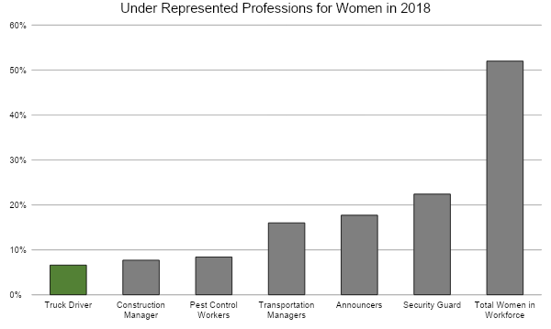

POTENTIAL TARGET MARKETS
Notes:
INTRO:Now let’s go into some of the possible key factors that could go in our predictive model Polina just outlined.
Here’s Barbara She is a 35-year-old store clerk whose husband has been a truck driver for 10 years and never gave a thought to becoming one herself. She’s one of the many women we would theoretically target in our marketing ads. She’s also one of the many potentially under represented woman in the trucking industry, so transalytics decided to look at other professions that are under represented and found that woman truck drivers were one of the lowest. Woman make up 52% of the work force and this is a major resource the trucking industry has ignored for too long as Security Guards at 22%, Pest Control work at 8.4% and Construction manager at 7.7% have more woman doing it than truck driver.%

Slide 16
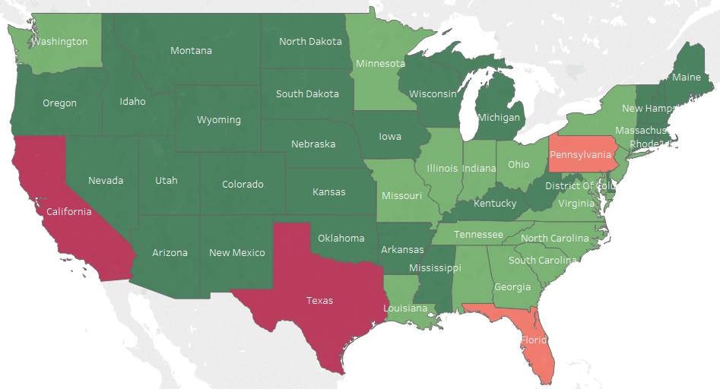

POTENTIAL TARGET MARKETS
Military Veterans by State 2010-2018
Top 5 States:
Texas
California
Pennsylvania
Florida
New York
Notes:
Here John a military veteran from Florida who has decided to return to civilian life. He has a CDL license for driving heavy duty trucks and vehicles for the army and doesn’t even know he can make a smooth transition to being a truck driver for a national company like Irish Express. We believe that a great way to garner interest from a veteran like John is to play up the founder’s, the late Paul O’Brian’s veteran status and provide his story with targeted ads to veterans. As you can see in the map, based on our analysis these five states should be targeted since they have a high concentration of veterans: California, Texas, Florida, Pennsylvania and New York. These states also have distribution and training centers nearby illustrated that will help alleviate some of the travel costs for the veterans when they receive training. If we were to use Veterans as one of our key factors the main reason would be because the states with the highest veterans also have training center.

Slide 17
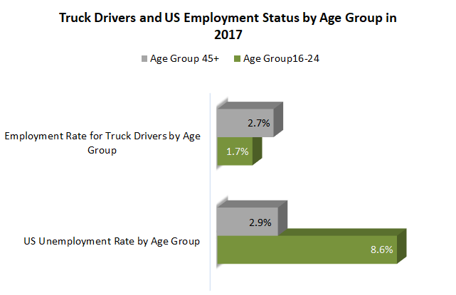

POTENTIAL TARGET MARKETS
Notes:
Here’s Tim he’s a 21-year-old apple store worker looking to change course but doesn’t know what to do. He enjoys driving and the open road but doesn’t know many professions that would allow him to do that for a living. If we were to use young adults as a factor, we can target a young individual like Tim through social media targeted ads that Tim might use like Waze and GasBuddy. Note that young individuals like Tim in the under 25 age group are underrepresented in the trucking industry as a whole as they make up only 1.7% of the work force for their age group compared to the 45+ age group (which is the age group of most truck drivers) which make up 2.7% of the work force for their age group. Also, the under 24 age group has a very high unemployment rate of almost 9% so this group is looking for opportunities and Transalytics believes, we can attract them by using social media ads, junior colleges and trade schools reimbursement programs.
There are so many factors that are important in making up our predictive model like woman, veterans and young adults and once we get your data we will be able to predict the right individuals for Irish Express.

Slide 18
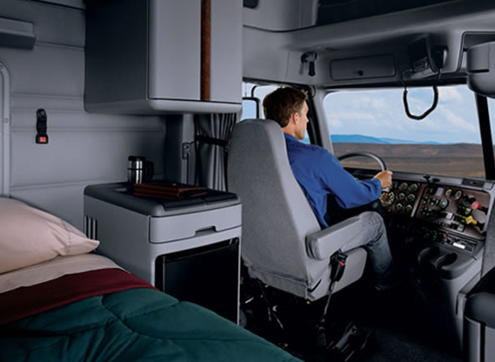
NO EMPTY SEATS ON YOUR FLEET
Notes:
Tyler
Our analytical approach to finding qualified and loyal drivers will allow Irish Express to experience:
-Greater Revenue Growth
-Happy, loyal drivers
AND
-Increase their seated truck percentage
We believe that we can leave no empty seats on your fleet..

Slide 19
Contact Information
Business Inquiries:
info@transalytics.com
312-312-4397
www.transalytics.com
Notes:
Our team can be reached at the information above
Thank you for your time
Questions?

